Slide 1

Towards Sharing and Compatibility Studies for WRC-27 Agenda item 1.7
Nairobi, Kenya

Slide 2
Agenda
Opening remarks – John Omo SG ATU /Elizabeth Migwalla
Introductory remarks-Mandialy Bodian Chair ATU WG2B
ATU survey results on current use of the bands in the region – Martial DHOSSA
Frequency band 7/8 GHz for IMT in the context of 6G developments – Elizabeth Migwalla
Overview of WRC-27 agenda item 1.7 – Geraldo Neto
Status of the ongoing sharing and compatibility studies – Geraldo Neto/ Punit Rathod
Characteristics and parameters from IMT and key existing services to be used in the studies – Geraldo Neto
BREAK
CASE STUDY: Sharing and compatibility between the fixed service and IMT in the 7125-8400 MHz band – Geraldo Neto, Punit Rathod
Conclusions, next steps-All
Closing remarks – Elizabeth Migwalla, ATU representative

Slide 3
Opening remarks

Slide 4
ATU survey results on current use of the bands in the region

Slide 5
Frequency band 7/8 GHz for IMT in the context of 6G developments

Slide 6
The 7/8 GHz band and the future of IMT
High-capacity upper-mid band spectrum is essential to support 6G development and deployment
Positioned between traditional mid-band and mmWave spectrum, the frequency band 7125-8400 MHz is perfectly positioned for low-latency, high-throughput IMT use
This band has similar propagation characteristics to mid-band spectrum, enabling coverage and allowing operators to increase network capacity
Balances capacity and coverage, making it an ideal band for urban deployments
Wider bandwidths in the upper-mid band range allow for high-performance applications

Slide 7
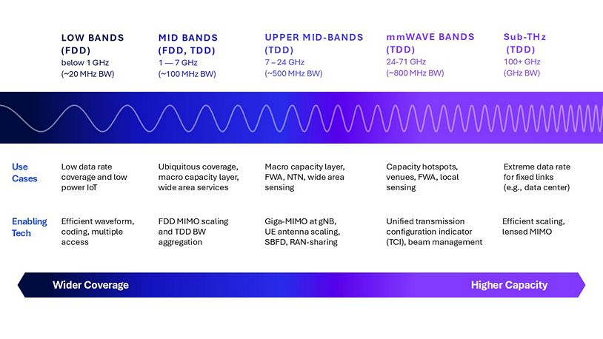
The 7/8 GHz band is a key piece of the 6G spectrum puzzle
Source: Qualcomm and RCR Wireless

Slide 8
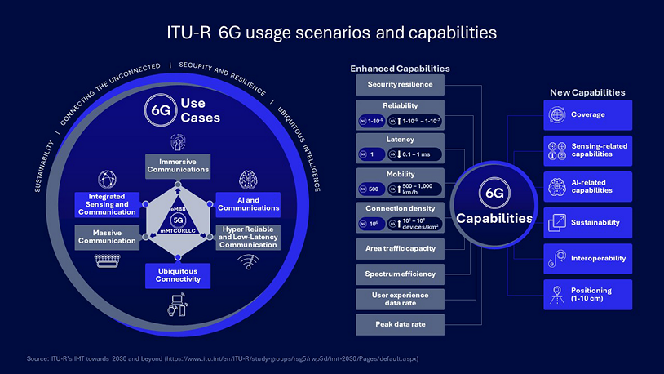
6G will be a transformative force in mobile communications
Deploying the 7/8 GHz band for IMT will enable next-generation connectivity applications
6G will support enhanced capabilities, including:
AI-native networks and devices
Immersive extended reality (XR)
Smart industry and robotics
Fixed wireless access
IoT
Connected transportation
Critical communications

Slide 9
Overview of WRC-27 agenda item 1.7

Slide 10
WRC-27 agenda item 1.7
Overview
Sharing and compatibility studies and development of technical conditions for the use of IMT in the frequency bands 4 400-4 800 MHz, 7 125-8 400 MHz (or parts thereof), and 14.8-15.35 GHz
ITU-R is invited to complete (for the above frequency bands):
appropriate studies of technical, operational and regulatory issues pertaining to the possible use of the terrestrial component of IMT
sharing and compatibility studies, with a view to ensuring the protection of services to which the frequency band is allocated on a primary basis … and also on services in adjacent bands
WRC-27 is invited to consider, based on results of studies, the identification of frequency band(s):
  4 400-4 800 MHz, or parts thereof, in Region 1 and Region 3;
  7 125-8 400 MHz, or part thereof, in Region 2 and Region 3;
  7 125-7 250 MHz and 7 750-8 400, or part thereof, in Region 1;
  14.8-15.35 GHz,
for the terrestrial component of IMT

Slide 11
WRC-27 agenda item 1.7
Background of draft CPM text
On top of list the activities required to be studied, indicate its importance for IMT-2030
“... These studies aim to support the growing demand for IMT, particularly in the context of IMT-2030, which emphasizes ultra-low latency and high-data-rate applications…
IMT-2030 requires harmonized spectrum allocations to enable global roaming and economies of scale. As the demand for IMT services grows, contiguous spectrum blocks become essential for supporting emerging applications…
At WRC-27, based on the results of study, the identification of all or parts of these frequency bands will be considered in different regions. The goal is to address the growing IMT needs while ensuring compatibility with existing services, fostering technological advances, and supporting developing countries.”

Slide 12


WRC-27 agenda item 1.7
Organization of the sharing and compatibility studies
Sharing and compatibility studies under WRC-27 agenda item 1.7 – main part
Key-issue (Working document / Report)
Common elements
References to all incumbent LS
Annex 1: Sharing and compatibility studies of IMT systems in the frequency band 4 400-4 800 MHz
(6 attachments)
DG 4 GHz
Mr Masayoshi TACHIKI (J)
Annex 2: Sharing and compatibility studies of IMT systems in the frequency band 7 125-8 400 MHz
(14 attachments)
DG 7/8 GHz
Dr Punit RATHOD (IND)
Annex 3: Sharing and compatibility studies of IMT systems in the frequency band 14.8-15.35 GHz
(4 attachments)
DG 14/15 GHz
Mr Vladislav SOROKIN (RUS)

Slide 13

WRC-27 agenda item 1.7
Timeline
2024
2025
2026
2027
5D
5D
5D
5D
5D
5D
5D
5D
5D
5D
5D
WRC-27
#45
#46
#47
#48
#49
#50
#51
#52
#53
#54
CPM-2
#55
Characteristics of IMT for WRC-27
WRC-27 Share and compatibility study
ITU-R
Draft CPM report
Propagation models and characteristics of the existing services provided by WPs 3K/3M, 4A, 4C, 5B, 5C, 7B, 7C, 7D

Slide 14
Status of the ongoing sharing and compatibility studies

Slide 15
WRC-27 agenda item 1.7
Sharing and compatibility with existing services
Fixed services (FS)
Fixed satellites (FSS)
Meteorological Satellites (MetSat)
Earth Exploration Satellites (EESS)
Mobile Satellites (MSS)
Space Research (SRS)
Space Operation (SOS)
Radio Astronomy (RAS)
Aeronautical mobile (AMRS)
Radio navigation (ARNS) ➔ e.g., Radio altimeters, WAIC
4400-4800 MHz
7125-8400 MHz
14.8–15.35 GHz
FS
FS
FS
FSS
FSS
SRS
AM(R)S
MSS
EESS (passive)
ARNS
MetSat
RAS
EESS
SRS
(passive)
SRS
SOS

Slide 16
WRC-27 agenda item 1.7
Sharing and compatibility with existing services in the frequency band 7125-8400 MHz
R1, R3
R1
R1
R1, R2, R3
R2, R3
R2, R3
4 GHz
5
6
7
8
9
10
11
12
13
14
15 GHz
UWB Channel #6
UWB Channel #8
UWB Channel #9
UWB Channel #19
Military
Military
METEO s-E
METEO
s-E
E-s
Radio
Location
EESS
E-s
MSS
s-E
MARITIME MOBILE SAT s-E
MSS
E-s
EESS s-E
EESS
active
MOBILE
FSS E-s
SOS / SRS E-s
FSS s-E
FSS E-s
SRS
s-E
SRS
active
FIXED
6700
7075
7145
7190
7235
7250
7300
7375
7450
7550
7750
7900
8025
8175
8215
8400
8500
8550
8650

Slide 17
WRC-27 agenda item 1.7
Sharing and compatibility with existing services in the frequency band 7125-8400 MHz
Service | Frequency Ranges | Contributing WPs
7 125-8 400 MHz (contributing groups: WP 5C, WP 4A, WP 4C, WP 5B, WP 7B, WP 7C, WP 7D, WP 1B)
Fixed | 7 125-8 400 MHz | WP 5C
Fixed satellite (space to Earth) | 7 250-7750 MHz | WP 4A
Fixed satellite (Earth to space) | 7900-8400 MHz | WP 4A
Space operation | 7 100-7 155 MHz and 7 190-7 235 MHz | WP 7B
Space research (deep space) (Earth-to-space) | 7 145-7 190 MHz | WP 7B
Earth exploration-satellite (Earth-to-space) | 7 190-7 250 MHz | WP 7B
Earth exploration-satellite (space-to-Earth) | 8 025-8400 MHz | WP 7B
Mobile satellite (space-to-Earth) | 7 375-7 750 MHz | WP 4C
Meteorological satellite (space-to-Earth) | 7 450-7 550 MHz, 7 750-7 900 MHz | WP 7B
Meteorological satellite (Earth-to-space) | 8 175-8 215 MHz | WP 7B

Slide 18
WRC-27 agenda item 1.7
Sharing and compatibility with existing services in the frequency band 7125-8400 MHz
The sharing and compatibility studies for the frequency band 7125-8400 MHz are contained in the attachments to this Annex 2 of the working document:
Attachment 1: Sharing between the fixed service and IMT operating in the frequency band 7 125-8 400 MHz
Attachment 2: Sharing between the space research service (Earth-to-space) in the frequency band 7 145-7 235 MHz and IMT operating in the frequency band 7 125-8 400 MHz
Attachment 3: Sharing between the space operation service (Earth-to-space) (see No. 5.459) in the frequency bands 7 100-7 155 MHz and 7 190-7 250 MHz and IMT operating in the frequency band 7 125-8 400 MHz
Attachment 4: Sharing between the fixed satellite service (space-to-Earth) in the frequency band 7 250-7 750 MHz and IMT operating in the frequency band 7 125-8 400 MHz
Attachment 5: Sharing between the fixed satellite service (Earth-to-space) in the frequency band 7 900-8 400 MHz and IMT operating in the frequency band 7 125-8 400 MHz
Attachment 6: Sharing between the mobile satellite service (space-to-Earth) (see RR No. 5.461) in the frequency band 7 250-7 375 MHz and IMT operating in the frequency band 7 125-8 400 MHz
Attachment 7: Sharing between the mobile satellite service (Earth-to-space) in the frequency band 7 900-8 025 MHz and IMT operating in the frequency band 7 125-8 400 MHz
Attachment 8: Sharing between the meteorological satellite service (space-to-Earth) in the frequency bands 7 450-7 550 MHz and 7 750-7 900 MHz and IMT operating in the frequency band 7 125-8 400 MHz
Attachment 9: Sharing between the meteorological satellite service (Earth-to-space) in the frequency band 8 175-8 215 MHz and IMT operating in the frequency band 7 125-8 400 MHz
Attachment 10: Sharing between the Earth exploration satellite service (space-to-Earth) in the frequency band 8 025-8 400 MHz and IMT operating in the frequency band 7 125-8 400 MHz
Attachment 11: Compatibility of the space research service (space-to-Earth) operating in the frequency band 8 400-8 500 MHz and IMT operating in the frequency band 8 215-8 400 MHz
Attachment 12: Sharing between the Earth exploration satellite service (Earth-to-space) operating in the frequency band 7 190-7 250 MHz and IMT operating in the frequency band 7 125-8 400 MHz
Attachment 13: Sharing between the maritime mobile satellite service (space-to-Earth) operating in the frequency band 7 375-7 750 MHz and IMT operating in the frequency band 7 125-8 400 MHz
Attachment 14: Existing services into IMT

Slide 19
Characteristics and parameters from IMT and key existing services to be used in the studies

Slide 20
WRC-27 agenda item 1.7
Characteristics to be used in the sharing and compatibility studies
WP 5D/ | Source | Services/Applications/Models
563 (Annex 4.15) | WP 5D | International Mobile Telecommunications (IMT)
160, 629 | WPs 3K/3M | Propagation models
118, 610 | WP 4A | Fixed-satellite service (FSS) / RR Appendix 30B including detailed information provided by the BR in Document 5D/254R1 Broadcasting-satellite service (BSS)
108, 418, 596 | WP 4C | Mobile-satellite service (MSS) Maritime mobile-satellite service (MMSS)
 | WP 5A | Land mobile service excluding IMT (LMS) Amateur service Amateur-satellite service
127, 425, 427, 604, 608 | WP 5B | Maritime mobile service (MMS) Aeronautical mobile service (AMS) Aeronautical mobile (R) service (AM(R)S) Radiodetermination service Aeronautical radionavigation service (ARNS)
129 | WP 5C | Fixed service (FS)
92, 403, 578 | WP 7B | Space operation service (SOS) Space research service (SRS) Earth exploration-satellite service (EESS) Meteorological-satellite service (MetSat)
87 | WP 7C | Earth exploration-satellite service (passive) (EESS (passive))
404 | WP 7D | Radio astronomy service (RAS)

Slide 21
BREAK

Slide 22
CASE STUDY: Sharing and compatibility between the fixed service and IMT in the 7125-8400 MHz band

Slide 23
Case study
Sharing and compatibility between the fixed service and IMT in the 7 125-8 400 MHz band
  How a sharing and compatibility study is structured
  What are the required parameters from IMT, including those that are set and those that need to be adjusted based on national conditions
  What are the required parameters from fixed service, including those that are set and those that need to be adjusted based on national conditions
  Propagation models to be used
  Simulation scenarios and methodology
  How to present results and summary of studies
  Summary of the results of the studies already provided with FS
  Study results and related regulatory conditions

Slide 24
Introduction
Objective of sharing and compatibility studies
  Ensure IMT deployment does not cause harmful interference to existing services
  Results may indicate coordination between countries on cross border issues
  Does not address national only matters, but may support future national regulations
Studies include in general three types of analysis:
  UL studies, i.e., assess the interference levels seen by satellites e.g., SRS, FSS, MSS, EESS, etc.
  DL studies, i.e., assess the interference levels seen by terrestrial stations e.g., FSS, Met Sat, etc.
  Terrestrial studies, i.e., assess the interference levels seen by the FS stations

Slide 25
Sharing and compatibility between the fixed service and IMT in the 7 125-8 400 MHz band
Support possible regulatory provisions based on technical analysis
Sharing studies determines whether new systems can share the spectrum with existing systems
  Based on minimum coupling loss (MCL) analysis and/or Montecarlo simulations
  Both co-channel operation and coexistence in the out-of-band and spurious domain
  Determine key RF limits, e.g., including in-band power and out-of-band emissions needed to protect existing services
Base station emissions are typically the determinant factor, not the UE
Configuration
Scenario
BS Deployment
System and network parameters selection
Rural Macro, Urban Macro , Micro, Indoor
Based on scenario and relevant ISD
Metrics
Propagation
UE deployment
SINR, C/I, degradation due to interference
PL, antenna gains, CL, cross-interference
Randomly dropped UEs in each IMT cell

Slide 26
Sharing and compatibility between the fixed service and IMT in the 7 125-8 400 MHz band
Steps for the analysis
Step 1: Define IMT system parameters
Step 2: Define existing system parameters: FS, FSS, MSS, MetSat, EESS, RAS, SRS, etc.
Step 3: Select environmental factors: terrain, clutter, propagation models
Step 4: Select layout and coexistence scenarios: co-channel, adjacent channel, urban, suburban, rural
Step 5: Simulate interference levels using simulation tools, e.g., MATLAB, SEAMCAT, etc.
Step 6: Determine separation distances based on protection level for the existing services, e.g., using I/N CDFs
Step 7: Determine if mitigation techniques or coordination between IMT and existing services could reduce the separation distances
Step 8: Analyze the results and summarize the findings

Slide 27
Sharing and compatibility between the fixed service and IMT in the 7 125-8 400 MHz band
Step 1, 2: Define system parameters
IMT parameters are defined WP 5D based on information from 3GPP
IMT parameters are captured in chair’s report Document 5D/563 Annex 4.15
IMT parameters include, among others:
  BS deployment characteristics, e.g., cell radius, antenna height, network load factor, BS TDD activity factor, etc.
  UE deployment characteristics, e.g., UE heights, indoor ration, UE TDD activity factor, etc.
  BS AAS antenna characteristics, e.g., antenna pattern, number of elements, element gain, down-tilt, BS EIRP, etc.
Incumbents’ parameters and protection criteria are defined by contributing WPs
Incumbents' parameters (terrestrial stations, e.g., fixed service ) include but not limited to:
  Channel bandwidth
  Antenna gain, antenna pattern
  Noise figure
  Antenna height
  Losses

Slide 28
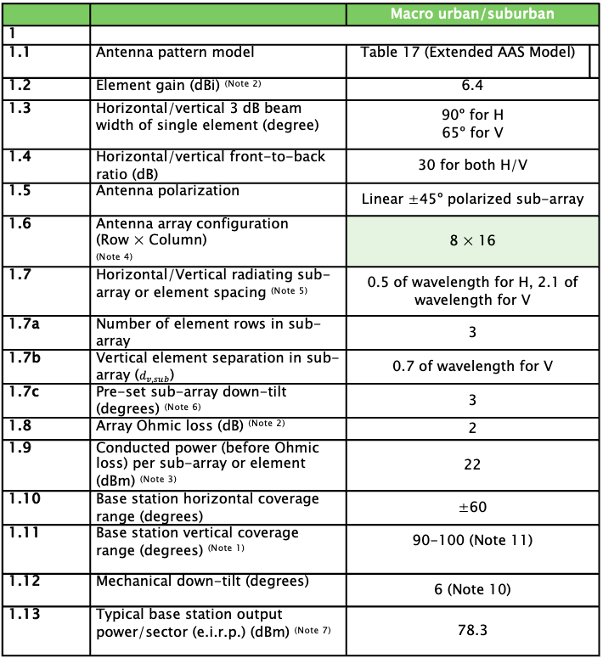
Sharing and compatibility between the fixed service and IMT in the 7 125-8 400 MHz band
IMT parameters are captured in WP 5D chair’s report, Document 5D/563 Annex 4.15
BS AAS parameters
BS parameters
UE parameters
 |  | Macro urban/suburban
1
1.1 | Antenna pattern model | Table 17 (Extended AAS Model)
1.2 | Element gain (dBi) ^{(Note 2)} | 6.4
1.3 | Horizontal/vertical 3 dB beam width of single element (degree) | 90º for H 65º for V
1.4 | Horizontal/vertical front‑to‑back ratio (dB) | 30 for both H/V
1.5 | Antenna polarization | Linear ±45º polarized sub-array
1.6 | Antenna array configuration (Row × Column) ^{(Note 4)} | 8 × 16
1.7 | Horizontal/Vertical radiating sub-array or element spacing ^{(Note 5)} | 0.5 of wavelength for H, 2.1 of wavelength for V
1.7a | Number of element rows in sub-array | 3
1.7b | Vertical element separation in sub-array ($d_{v,sub}$) | 0.7 of wavelength for V
1.7c | Pre-set sub-array down-tilt (degrees) ^{(Note 6)} | 3
1.8 | Array Ohmic loss (dB) ^{(Note 2)} | 2
1.9 | Conducted power (before Ohmic loss) per sub-array or element (dBm) ^{(Note 3)} | 22
1.10 | Base station horizontal coverage range (degrees) | ±60
1.11 | Base station vertical coverage range (degrees) ^{(Note 1)} | 90-100 (Note 11)
1.12 | Mechanical down-tilt (degrees) | 6 (Note 10)
1.13 | Typical base station output power/sector (e.i.r.p.) (dBm) ^{(Note 7)} | 78.3
 | Urban/Suburban
Cell Radius / Deployment density (Note 1) | Typical cell radius 0.4 km urban / 0.8 km suburban
Antenna height | 18 m urban / 20 m suburban
Sectorization | 3 sectors
Frequency reuse | 1
Indoor base station deployment | N/A
Indoor base station penetration loss | N/A
Below rooftop base station antenna deployment (Note 4) | Urban: 65% Suburban: 15%
Typical channel bandwidth (Note 5) | 100 MHz
Network loading factor (base station load probability X%) (see section 6 below and Rec. ITU-R M.2101 Annex 1, section 3.4.1 and 6) | 20%
TDD / FDD | TDD
BS TDD activity factor | 75%
 | Urban /Suburban
Indoor user terminal usage | 70%
Indoor user terminal penetration loss | Rec. ITU-R P.2109
User equipment density for terminals that are transmitting simultaneously (Note 1) | 3 UEs per sector
UE height | 1.5 m
Average user terminal output power | Use transmit power control
Typical antenna gain for user terminals | −4 dBi
Body loss | 4 dB
UE TDD activity factor | 25%
Power control model | Refer to Recommendation ITU-R M.2101 Annex 1, section 4.1
Maximum user terminal output power, PCMAX | 23 dBm
Power (dBm) target value per RB, P0_PUSCH (Note 3) | −92.2
Path loss compensation factor, a (same as “balancing factor” mentioned in Rec. ITU-R M.2101) | 0.8

Slide 29
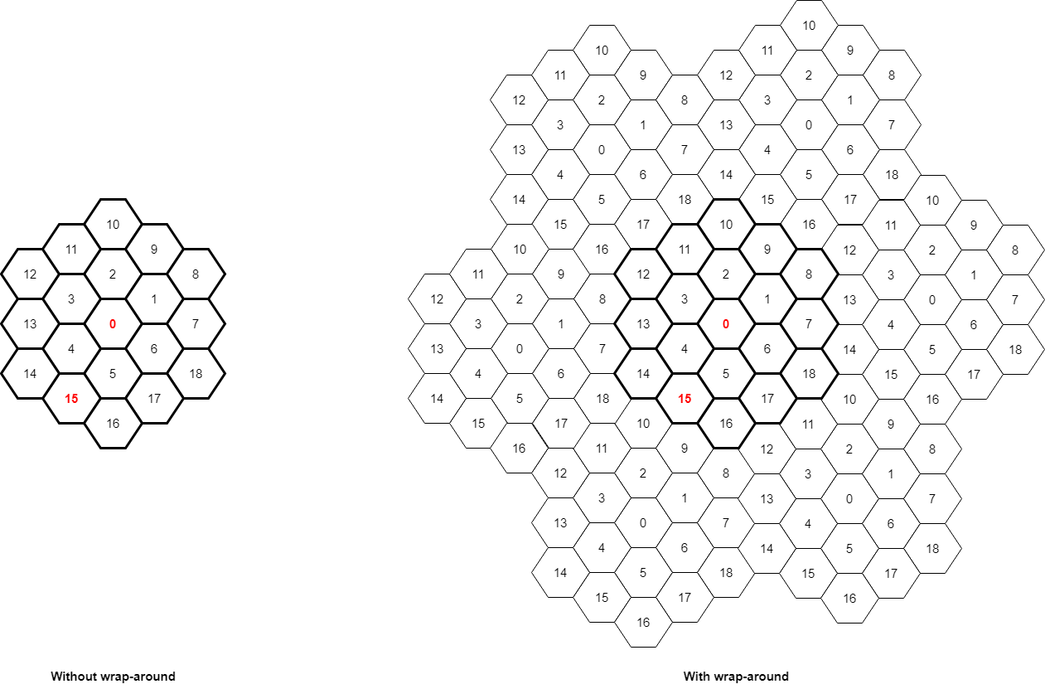
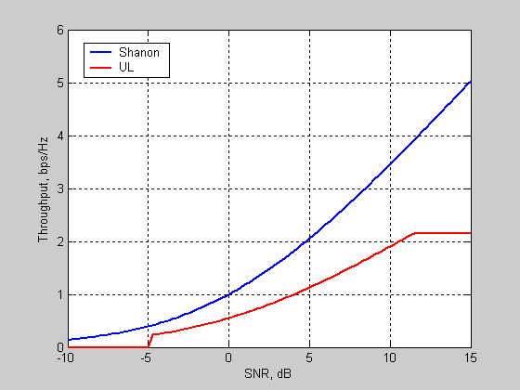
Sharing and compatibility between the fixed service and IMT in the 7 125-8 400 MHz band
IMT parameters are captured in WP 5D chair’s report, Document 5D/563 Annex 4.15
Single IMT system modeling (Rec. ITU-R M.2101)
3GPP evaluates the performance of the selected IMT parameters under several conditions, including:
  Propagation model (urban, suburban, rural)
  Interference from other cells
  User mobility
  Network topology
  Traffic models
Define the scenario
  Layout, ISD of BS, frequency & bandwidth, #UEs per cell, UL and DL
Generate the random variables, admission control and power control
  Drop UE randomly, selection BSs, power control
Wrap-around technique
  Uniform interference at the cluster edge
  This step is not needed in IMT aggressor simulations
Model the link level performance (SINR, throughput)
  This step is not needed in IMT aggressor simulations
Evaluate the system performance
  This step is not needed in IMT aggressor simulations

Slide 30
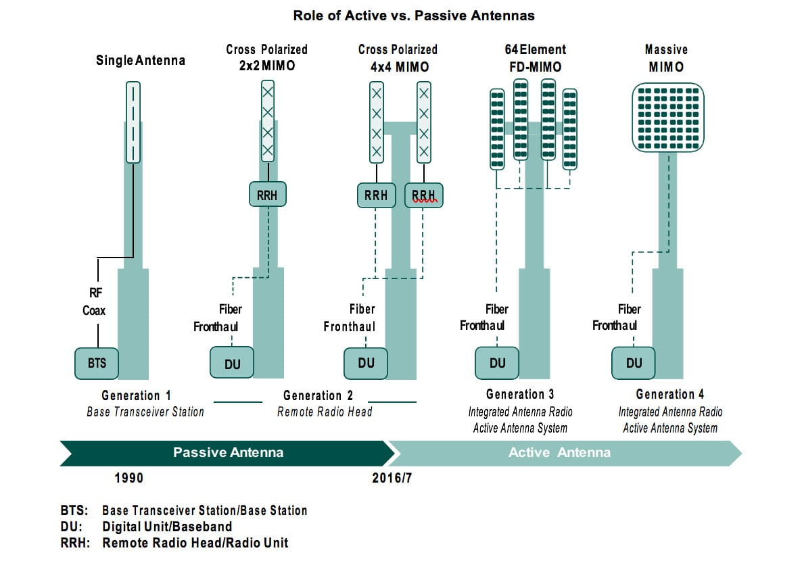
Sharing and compatibility between the fixed service and IMT in the 7 125-8 400 MHz band
AAS: active antenna systems
BS antennas are evolved across different generations from 2G till 5G and later 6G
Old systems used the non AAS antenna where the antenna was separated from the RRH (remote radio head)
New antenna systems (AAS) connect the TXRUs directly to the antenna elements (is being used now)
Newer antenna systems with AAS also is being evolved and include now subarrays of elements (represented in extended antenna model by 3GPP)
Source: RCR Wireless

Slide 31
Discussion
What would be the relevant IMT characteristics for your national conditions?

Slide 32
Sharing and compatibility between the fixed service and IMT in the 7 125-8 400 MHz band
FS parameters from WP 5C LS in Document 5D/129
Frequency range (GHz) | 7 110-7 900 |  | 7 725-8 500
Reference ITU‑R Recommendation | F.385 |  | F.386
Modulation | 16-QAM | 128-QAM | 16-QAM | 128-QAM
Channel spacing and receiver noise bandwidth (MHz) | 3.5, 5, 7, 10, 14, 20, 28, 30⁽³⁾, 40⁽³⁾, 60⁽³⁾, 80⁽³⁾ | 3.5, 5, 7, 10, 14, 20, 28, 30⁽³⁾, 40⁽³⁾, 60⁽³⁾, 80⁽³⁾ | 1.25, 2.5, 5, 7, 10, 11.662, 14, 20, 28, 29.65, 30, 40, 60⁽³⁾, 80⁽³⁾ | 1.25, 2.5, 5, 7, 10, 11.662, 14, 20, 28, 29.65, 30, 40, 60⁽³⁾, 80⁽³⁾
Tx output power range (dBW) | −6.5… 13 | −6.5…13 | −6.5… 13 | −6.5… 13
Tx output power density range (dBW/MHz)⁽¹⁾ | −25.5…3 | −25.5…3 | −25.5…3 | −25.5…3
Feeder/multiplexer loss range (dB) | 0…3.0 | 0…3.0 | 0…3.0 | 0…3.0
Antenna gain range (dBi) | 12…48.6 | 12…48.6 | 12…48.6 | 12…48.6
e.i.r.p. range (dBW) | 5.5…55 | 5.5…55 | 5.5…55 | 5.5…55
e.i.r.p. density range (dBW/MHz)⁽¹⁾ | −13.5…45 | −13.5…45 | −13.5…45 | −13.5…45
Receiver noise figure typical (dB) | 2.5…6 | 2.5…6 | 2.5…6 | 2.5…8
Receiver noise power density typical (=N_{RX}) (dBW/MHz) | −141.5… −138.0 | −141.5… −138.0 | −141.5…−138.0 | −141.5…−136
Normalized Rx input level for 1 × 10⁻⁶ BER (dBW/MHz) | −121.0… −117.5 | −112.5… −115.0 | −121.0…−117.5 | −111.3…−106.5
Nominal long-term interference power density (dBW/MHz)⁽²⁾ | −141.5… −138.0 + I/N | 138.0 + I/N | −141.5… −138.0 + I/N | −141.5… −136+ I/N
Several parameters come in ranges to reflect the different national conditions
Examples of required parameters to run sharing studies:
  Antenna heights are not reflected in the provided LS from WP5C
  Antenna gain
  Feeder loss
  Channel Bandwidth
  Noise figure
According to Rec. ITU-R F.758-7 the long-term protection criterion for FS systems, I/N is −10 dB, which should not be exceeded for more than 20% of the time

Slide 33
Discussion
What would be the relevant FS characteristics for your national conditions?

Slide 34
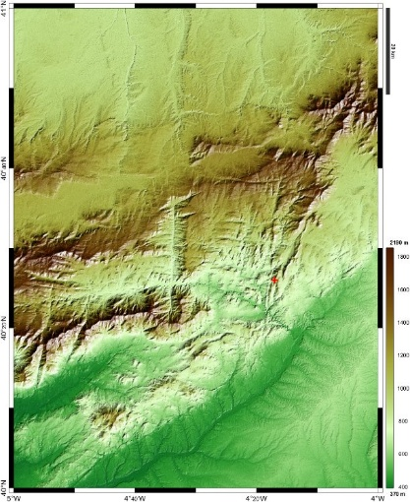
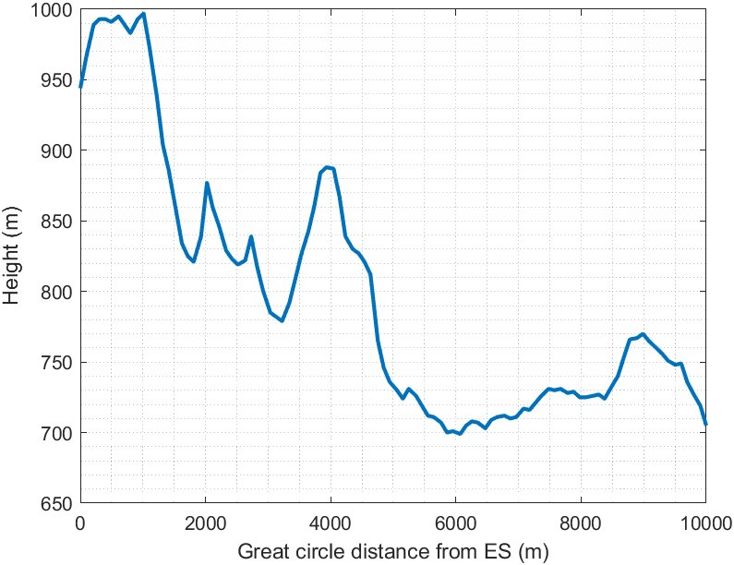
Sharing and compatibility between the fixed service and IMT in the 7 125-8 400 MHz band
Step 3: Selection of environmental factors
The propagation models for sharing and compatibility studies are provided by WPs 3K/3M
Examples of propagation models
  Rec. ITU-R P.2001 for terrestrial paths
  Rec. ITU-R P.458 for terrestrial paths
  Rec. ITU-R P.619 for earth to satellite path
Example of clutter model
  Rec. ITU-R P.2108 (to be applied for BS below rooftop, and/or at terrestrial station side)
Terrain models
  Terrain is supported by Recs. ITU-R P.452 and P.2001 channel models​
  Terrain data provides height information for all Lat/Lon positions
  ​Path profile is given by a distance and a height vector
  Terrian model is used when doing “site specific study”, i.e., the location of the stations is known
  If location of station is not known, terrain is not used in “site generic study”, i.e., flat earth model

Slide 35
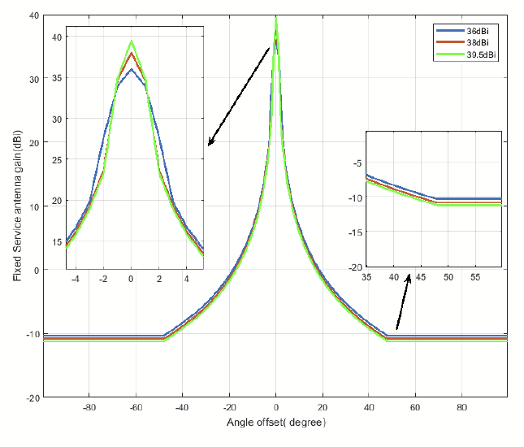
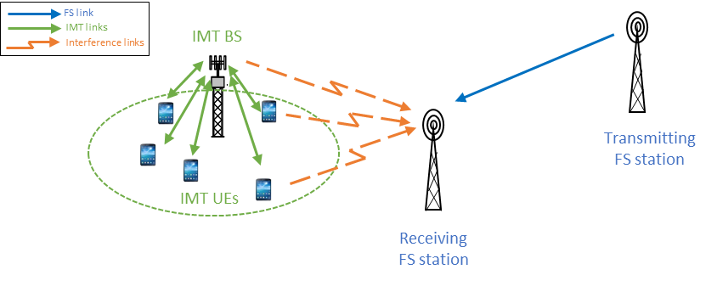
Sharing and compatibility between the fixed service and IMT in the 7 125-8 400 MHz band
Step 4: Select layout and coexistence scenarios
Layout
  IMT deployment follows Rec. ITU-R M.2101 with 57 hexagonal cells
  3 UEs are dropped in each cell randomly every time instance (i.e., snapshot)
  Incumbent, e.g., FS station is placed within various separation distances and angles from the IMT cluster
Scenario
  Select different cases to represent realistic scenarios e.g.,
    Co-channel or adjacent channel based on the frequency band
    Urban, suburban, rural scenarios

Slide 36
Discussion
What would be the relevant layouts and scenarios for your national conditions?

Slide 37
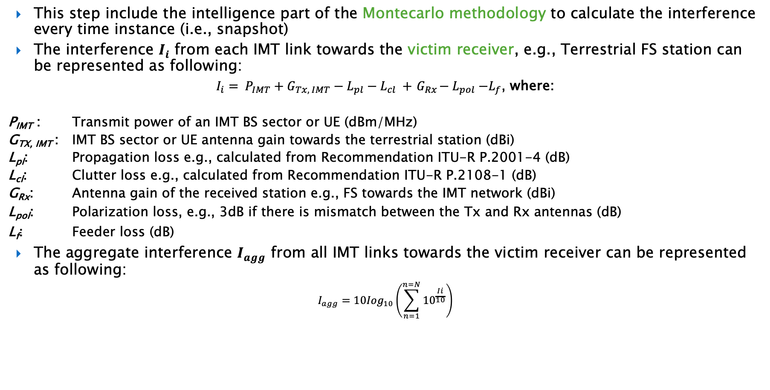
Sharing and compatibility between the fixed service and IMT in the 7 125-8 400 MHz band
Step 5: Simulate interference levels
This step include the intelligence part of the Montecarlo methodology to calculate the interference every time instance (i.e., snapshot)
The interference $I_{i}$ from each IMT link towards the victim receiver, e.g., Terrestrial FS station can be represented as following:
${I_{i}= P_{IMT}+G_{Tx, IMT}−L_{pl}−L}_{cl} {+{ G}_{Rx}−L}_{pol}−L_{f}$, where:
P_{IMT} : Transmit power of an IMT BS sector or UE (dBm/MHz)
G_{TX, IMT} : IMT BS sector or UE antenna gain towards the terrestrial station (dBi)
L_{pl}: Propagation loss e.g., calculated from Recommendation ITU-R P.2001-4 (dB)
L_{cl}: Clutter loss e.g., calculated from Recommendation ITU-R P.2108-1 (dB)
G_{Rx}: Antenna gain of the received station e.g., FS towards the IMT network (dBi)
L_{pol}: Polarization loss, e.g., 3dB if there is mismatch between the Tx and Rx antennas (dB)
L_{f}: Feeder loss (dB)
The aggregate interference $I_{agg}$ from all IMT links towards the victim receiver can be represented as following:
$$I_{agg}=10{Iog}_{10}\left(\sum_{n=1}^{n=N}{10^{\frac{Ii}{10}}}\right)$$

Slide 38
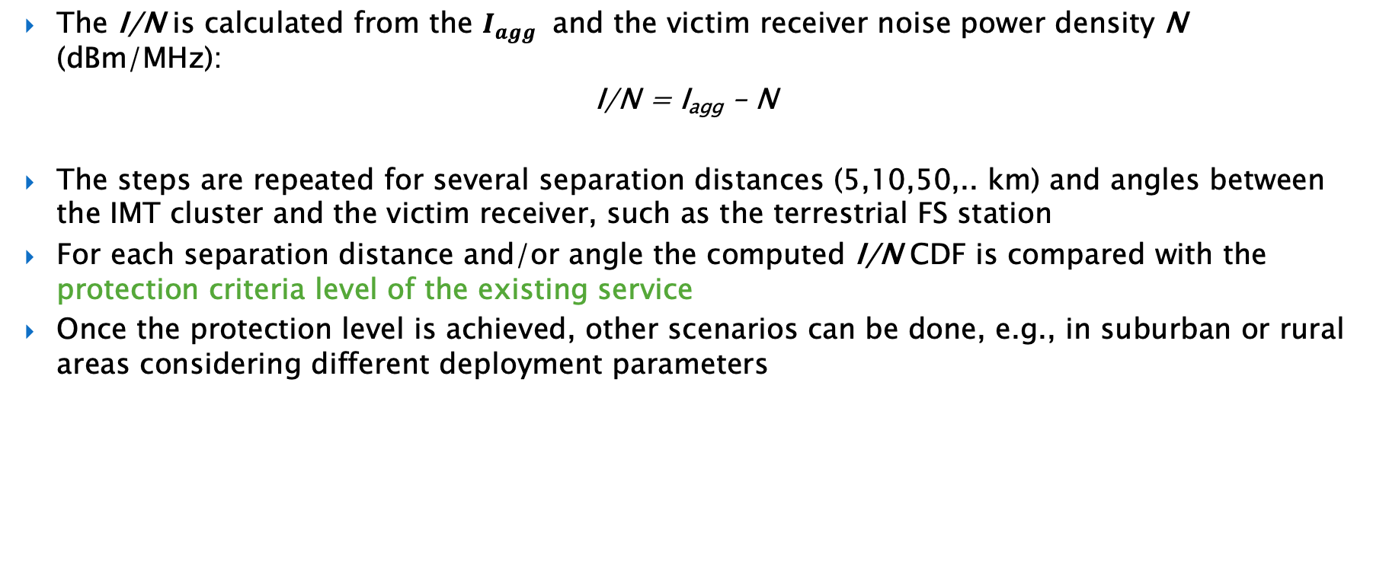
Sharing and compatibility between the fixed service and IMT in the 7 125-8 400 MHz band
Step 6: Determine separation distances based on protection level for the existing services
The I/N is calculated from the $I_{agg}$ and the victim receiver noise power density N (dBm/MHz):
I/N = I_{agg} – N
The steps are repeated for several separation distances (5,10,50,.. km) and angles between the IMT cluster and the victim receiver, such as the terrestrial FS station
For each separation distance and/or angle the computed I/N CDF is compared with the protection criteria level of the existing service
Once the protection level is achieved, other scenarios can be done, e.g., in suburban or rural areas considering different deployment parameters

Slide 39
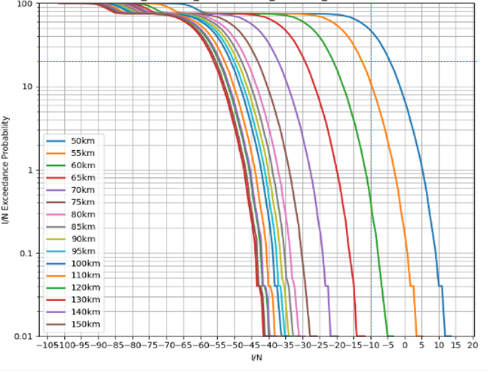
Sharing and compatibility between the fixed service and IMT in the 7 125-8 400 MHz band
Example of CDFs of I/N results for study between IMT and FS
The protection criteria for FS is I/N -10 dB at 20% time of the CDF
The calculated I/N value considering the IMT interference I over thermal Noise N of the FS must be lower the protection criteria at this 20% time of the CDF
Several separation distances and angle variations between IMT and FS are simulated in order to find the scenarios in which the protection criteria is met

Slide 40
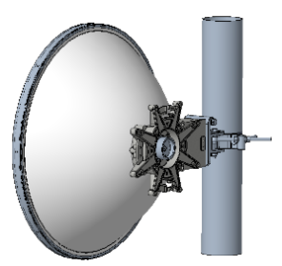
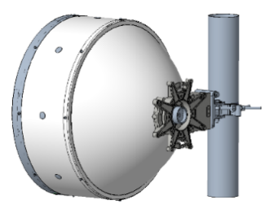
Sharing and compatibility between the fixed service and IMT in the 7 125-8 400 MHz band
Step 7: Determine if mitigation techniques or coordination between IMT and existing services could reduce the separation distances
Mitigation techniques can also be studied to reduce separation distances
Possible separation approach between IMT and FS
  Separation in geography/space
  Separation in frequency
  Angular discrimination
  Combination of the above
Examples of mitigation techniques and other considerations
  Example techniques applicable to fixed service
    Adding an antenna shroud to the antenna of the FS receiver can improve isolation by:
      around 15 dB at azimuth angles from around 20 to 85 degrees;
      around 7 dB in the Front-to-Back (F/B) ratio.
  Examples of mitigation techniques applicable for IMT
    Careful choice of the IMT site locations;
    Reduction of antenna height;
    Reduction of transmitter power;
    Increased antenna tilt;
    Ensuring Non-Line-of-Sight (NLoS) propagation between IMT and FS stations.
FS antenna without shroud and with shroud

Slide 41
Sharing and compatibility between the fixed service and IMT in the 7 125-8 400 MHz band
Step 8: Analyze the results and summarize the findings
The summary should contain the key parameters and considerations of the study to facilitate the comparison with other studies
It should highlight the main findings and whether any mitigation technique is necessary in order to prove feasibility
Example:
  The study has addressed a scenario for IMT stations interfering to the FS station for co-frequency situation, assuming the receiving FS station faces to an IMT network in azimuth angle and with a flat (smooth-Earth) profile. The aggregate interference simulations from an IMT network towards the FS station have been performed in the 7 125-8 400 MHz frequency band. This study provided separation distances to achieve I/N −10 dB not exceeded by 20% of time for the four different examples of the FS systems, namely, Examples 1 and 2 for rural area, as well as Examples 3 and 4 for urban area. Those Examples, provided for the frequency band below 7 025 MHz by WP 5C, were assumed as typical parameters of the FS in the frequency band 7 125-8 400 MHz.
  In the case of assuming 20% of network loading factor and clutter loss applied to all IMT BSs, the separation distances ranged from less than 5 km to 57 km, depending on the type of deployment of IMT network and the FS station. When the 50% of network loading factor was assumed, the separation distances increased to less than 5 km to 61 km. Alternatively, when clutter loss applied to below rooftop BSs was assumed, the separation distances increased to 35 to 95 km. Overall, the study showed that the separation distances from an IMT network to the FS station ranged from less than 5 km to 95 km, depending on the assumed network loading factor, clutter loss and deployment types of FS, when the nearest IMT BS faces to the FS main beam direction in azimuth. It should be noted that the separation distance might be decreased if the interference from IMT network was received at side lobe of the FS receiver or terrain profile was considered in the path between IMT and the FS stations.

Slide 42
Sharing and compatibility between the fixed service and IMT in the 7 125-8 400 MHz band
Summary of the results of the studies already provided with FS
Six different studies have been provided up to the 49 meeting of WP 5D
Some of them already provide results and summaries:
  Brazil: up to 40 km based on sidelobe/backlobe
  Croatia, Turkey: initial study with no results
  India: initial study with no results
  Japan: 5 to 95 km based on clutter options
  United States: 2 to 53 km based on sidelobe/backlobe
  Saudi Arabia: 2 to 51 km based on sidelobe/backlobe

Slide 43
Sharing and compatibility between the fixed service and IMT in the 7 125-8 400 MHz band
Study results and related regulatory conditions
Specific mitigation measures applicable to terrestrial IMT network to ensure protection of incumbent systems depend on the existing system to be protected
  In case of a terrestrial victim system, typical mitigation measures involve a separation distance or coordination zone around the existing service’s stations
  In case the goal is to protect satellite stations, the typical measures involve control of the base station power
With the introduction of large antenna arrays and AAS in IMT deployments, different techniques can be adopted to facilitate sharing and coexistence between IMT and existing systems, such as side lobe suppression, antenna steering as well as nulling in a specific direction
Regulatory considerations:
Distances provided in the FS studies so far indicate separation distances mostly related to national level considerations, leading to possible examples of regulatory text as in previous cycles:
  invites the ITU Radiocommunication Sector
  3 to update existing ITU‑R Recommendations/Reports or develop new ITU‑R Recommendations/Reports, as appropriate, to provide information and assistance to the administrations concerned on possible coordination of stations in the fixed service with IMT stations in the frequency band 7 125-8 400 MHz;

Slide 44
Conclusions, next steps, and closing remarks

Slide 45
THANK YOU

Slide 46
Back Up Slides

Slide 47
Supporting joint government-industry work to develop technical contributions to WP 5D
During sub-regional consultations, several Administrations expressed interest in pursuing joint government-industry work aimed at developing technical studies to WP 5D
Thus far, attention has focused on sharing and compatibility studies between the fixed service and IMT in the frequency band 7125-8400 MHz – particularly with respect to scenarios that mirror real-world, national conditions
This side event aims to support regional preparation for WRC-27 agenda item 1.7 by fostering technical understanding, information exchange, and industry-government collaboration
The event lays the groundwork for collaborative contributions that reflect local realities and strengthen the region’s voice in ITU discussions

Slide 48
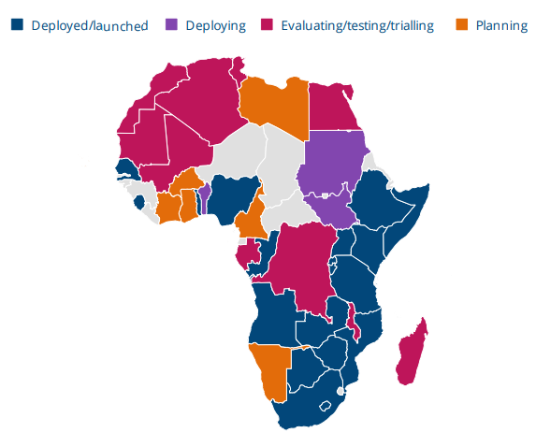
Allocating additional IMT spectrum to advance connectivity goals
Africa’s connectivity ecosystem continues to grow, but more spectrum could help support advanced wireless use cases
As of September 2024, 79 operators in 41 countries have invested in 5G mobile or fixed wireless access services
  35 operators in 21 countries have already launched 5G networks
  26 operators in 19 countries have soft-launched or tested 5G networks
  17 operators in 14 countries are currently planning 5G deployments
By 2030, 5G is projected to account for more than 226 million mobile connections in the region
As the foundation for current and future connectivity needs, including 6G, additional IMT spectrum can help expand access, close the digital divide, and support the implementation of next-generation connectivity infrastructure across the region
Source: Global mobile Suppliers Association (GSA), GSMA

Slide 49

Leveraging the frequency band 7125-8400 MHz
Balancing IMT growth with protection of existing fixed service deployments
The frequency band 7125-8400 MHz offers significant potential for high-capacity IMT deployments, especially in regard to emerging 6G applications
WRC-27 studies must evaluate the feasibility of coexistence between IMT and incumbent fixed service links
Nationally representative scenarios are essential to ensure credible study outcomes, including:
  Existing fixed service deployments
  IMT rollout projections and spectrum demands by geography
  Typical link distances, antenna heights, and terrain types
These conversations will help improve the relevance of sharing studies and help shape discussions at WRC-27

Slide 50
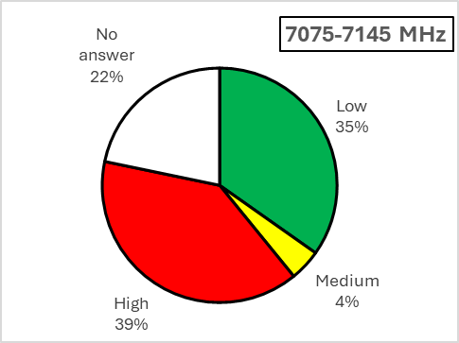
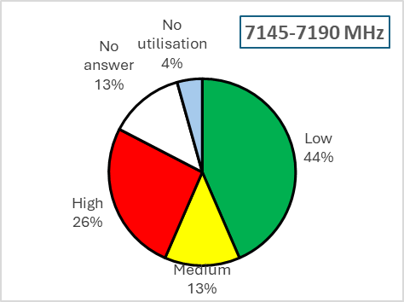
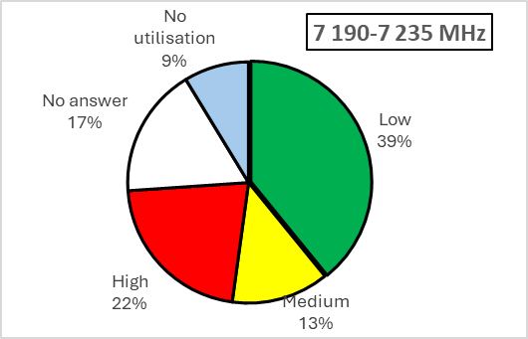
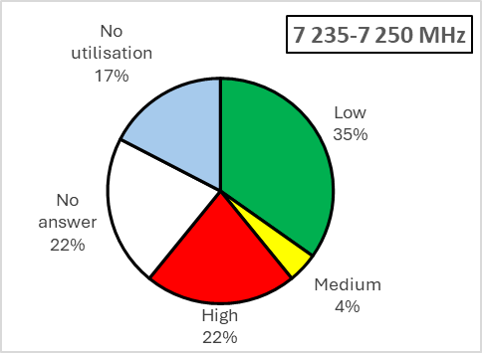
The current utilization of the 7/8 GHz band in ATU
7075-7250 MHz
All ATU Member States deployed FS in 7075-7145 MHz.
All ATU Member States deployed FS in 7145-7190 MHz.
The majority of ATU Member States deployed FS in 7190-7235 MHz.
The majority of ATU Members States deployed FS in 7235-7250 MHz.

Slide 51
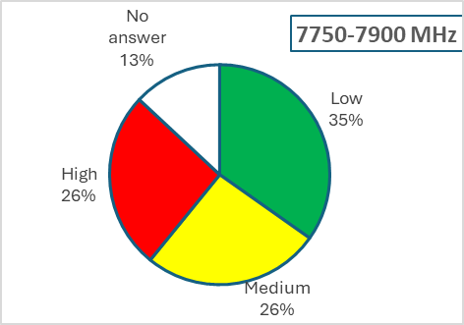
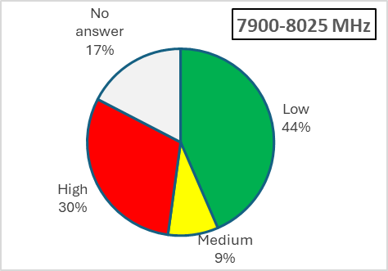
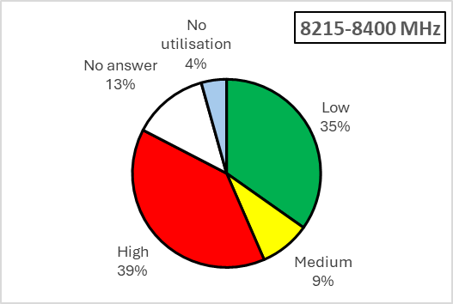
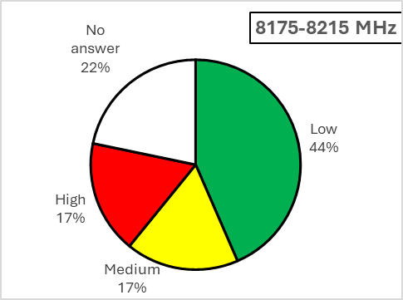
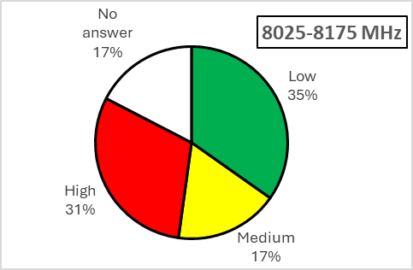
The current utilization of the 7/8 GHz band in ATU
7750-8400 MHz
All ATU Member States deployed FS in 7750-7900 MHz.
All ATU Member States deployed FS in 7900-8025 MHz.
All ATU Member States deployed FS in 8025-8175 MHz.
All ATU Member States deployed FS in 8175-8215 MHz.
All ATU Member States deployed FS in 8215-8400 MHz.

